Slide 1
The effect of learning style independent web-based atomised e-learning on achievement. (provisional)
Andy Wicks (Part-time, self-funded)
Supervisors: Prof. Liz Bacon, Prof. Lachlan McKinnon and Dr. Cos Ierotheou

Slide 2
Outline
Intended contribution
Types of learning/education
What is an atom of learning?
A discussion of ethics
How will it success/failure be measured?
Future work

Slide 3
Intended Contribution
Social contribution
To provide a learning style independent environment which is free at the point of use and allows anyone to contribute.
Academic contribution – gap in knowledge
To assess whether such a system brings any benefits for students, i.e. retention, achievement and willingness to upload atoms.
To assess whether the opportunity to record other kinds of learning will be taken up.

Slide 4
Types of Learning
Formal learning – Learning to pass a syllabus. This is where VLEs are used today.
Vicarious learning – Learning from others, such as in this seminar. We all learn from the feedback given here. (Chi et al, 2006)
Self-initiated learning – Things that we learn because it interest us, like a hobby or the news. (Condry, 1977)
VLEs don’t record the last two.

Slide 5
The Learning Equation
Learning = Formal Learning + Vicarious Learning + Self-initiated Learning
Or
L = F + V + S

Slide 6
The Education Equation
Education = Learning x Critical Thinking
Or
E = L x C

Slide 7
An atom? What is it?
Breaking a topic or syllabus into its smallest parts (atoms).
Atoms in this context have text, video, MP3 and PDF so that students can work as they want.
Linking these atoms together in a tree to form an assessable body of knowledge. (Marton and Säljö, 1976)
The student can then work from either end.
The teacher can reuse these atoms as needed.

Slide 8
What does an atom look like?
http://www.o-vl.com/index-2.php

Slide 9
Offices
http://www.o-vl.com/StaffOffice.php

Slide 10
A Discussion of Ethics
We cannot have one group use the system and another not. If the system works we are disadvantaging the non-participatory group. If it does not work we are disadvantaging those who do.
Individual results must not be identifiable.

Slide 11
Assessing Effectiveness
Assuming that a cohort of students find two courses to be:-
equally difficult.
equally motivating.
assessed to an equal standard.
taught to an equal standard.

Slide 12
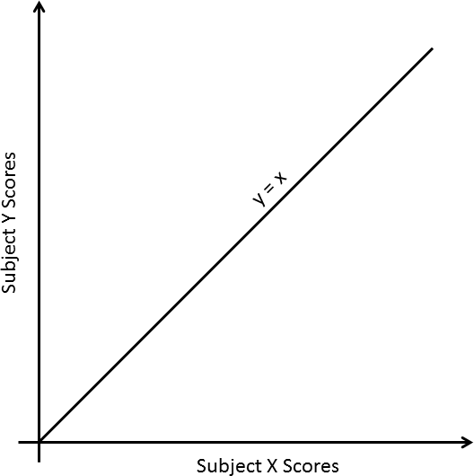
Assessing Effectiveness
If these four states were true then each student would score the same in each course.
Their score would only be related to their ability.

Slide 13
Learning Dissonance (LD)
Let’s compare two similar courses.
Differences in results can be explained by the assumptions being wrong.
The learning dissonance is being defined as the geometric mean of the differences in results for each student taking that pair of courses.

Slide 14
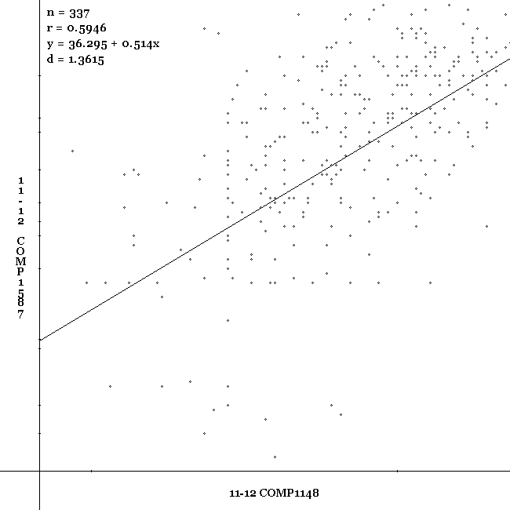
A Sample Graph
Academic Year 2011/12
COMP1148 :-
Introduction to Programming
COMP1587 :-
Communications Systems

Slide 15
Results 2011-12
COMP1152 COMP1587 MATH1110 MATH1111 COMP1588 COMP1589
COMP1148 6.060 8.287 8.422 7.011 8.518 7.671
COMP1152 7.965 6.668 6.670 9.179 7.864
COMP1587 9.770 9.538 7.367 9.913
MATH1110 7.957 7.110
MATH1111 8.556 8.014
COMP1588 6.190

Slide 16
LD Categories
The learning dissonance can be calculated for :-
Courses
Members of staff
Students
These will give a new insight into how students learn and the relative importance of each factor.

Slide 17
Cluster Analysis
There are too many factors, so how can we find what matters?
This will be a longitudinal study.
A large volume of data can yield clusters of causalities.

Slide 18
Future Work
*** Work on the literature review ***
Gather the data for all students in all years.
Calculate the LD for all courses.
Complete the cluster analysis.

Slide 19
Your turn to help me
I am new to all of this.
Please ask questions.
Please make comments.
This is how I will learn.

Slide 20
References
Chi, Michelene TH, Marguerite Roy, and Robert GM Hausmann. "Observing tutorial dialogues collaboratively: Insights about human tutoring effectiveness from vicarious learning." Cognitive science 32.2 (2008): 301-341.
Condry, John. "Enemies of exploration: Self-initiated versus other-initiated learning." Journal of Personality and Social Psychology 35.7 (1977): 459.
Marton F. and Säljö R. “On qualitative differences in learning. I – Outcome and Process”, British Journal of Educational Psychology 46, (1976) pp. 4-11.

